Slide 1
Opening the Door to IT Modernization – Selling Intel SSDs to replace HDDs
1 November 2015

Slide 2
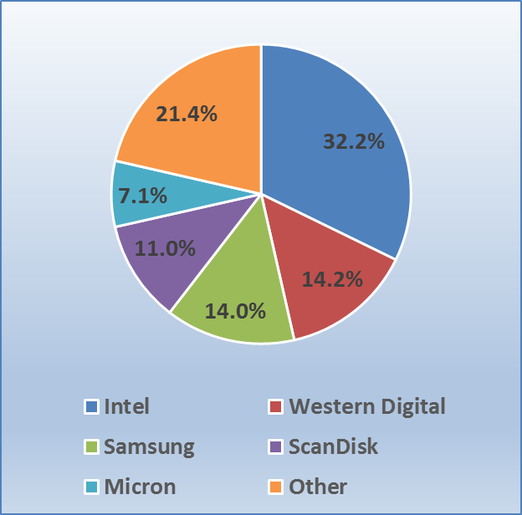
2014 Enterprise SSD Market Share
2015 Global SSD Market is $15 Billion
Western Digital remarkets Intel SSDs
Intel + Western Digital = 46.4% Effective Market Share for Intel SSDs
“Other” includes:
Fujitsu
HGST
Kingston
PMC
Seagate
SK-Hynix
Smart-Modular
Toshiba
Source: IDC
Notes:
The market share of Intel (32.2%) and Western Digital (14.2%) who remarkets Intel SSD drives, provides Intel SSDs with a commanding effective 46.4% market share for Intel SSD in the enterprise market. Additional providers with 21.4% market share in the ‘Other’ category include, but are not limited to: Fujitsu, HGST, Kingston, PMC, Seagate, SK-Hynix, Smart-Modular, and Toshiba.
The SSD industry is exploding. According to IDC, the overall market for SSDs globally was $15 Billion in 2015, up 21% from 2014. The driving factors in this growth include lower costs for SSDs, better performing drives, and ease of use -such as the adoption of the NVMe standard for PCIe form factor drives.
The Enterprise market segment for total HDDs and SSDs in the data center is estimated to be about 180,000 PB (Petabytes) in 2015. Of this amount, SSDs comprise less than 4% of the total disk in the data center. This leaves a very large market opportunity for technology refreshes for customers to move them from HDD based servers to new servers with SSDs, but also replacing existing HDDs with SSDs as an upgrade to give old servers new life and performance (Arrow ECS sells Intel SSDs standalone).

Slide 3
Solid State Technology – Different Dynamics
The SSD technology is fundamentally different than the technology used with traditional HDDs.
Hard Disk Drive (HDD)
Mechanical arm reads/writes data from spinning disk media
Slow access, high latency
Solid State Drive (SDD)
Uses multi-level cell (MLC) media, firmware controlled
Extreme performance, low latency
Connects using PCIe bus slot, SAS controller or SATA controller
Notes:
Sold-State Drive technology is fundamentally different than the technology used with traditional hard disk drives. The removal of the mechanical process used by HDDs for reading a spinning disk and replacing it with the Solid-State technology of SDDs provides extreme performance, increased throughput, and advanced reliability to the disk drives in the data center.
Firmware (software) controls the important characteristics of each manufacturer’s SSDs. Each accomplishes the same task – to store data, but they all contain different performance and reliability features. Much like Chrome, Firefox, and Explorer all access the Web with different speed and features.

Slide 4
The “Big 4” for Selecting a Data Center Solid-State Drive
Performance
Throughput
Consistency
Reliability
How fast is a random data transfer?
15K SAS HDDs provide only ~230 IOPS
Intel PCIe NVMe & SATA SSDs deliver 75,000 to 460,000 IOPS!
How fast is a sequential data transfer?
15K SAS HDDs provide only ~250 MB/s
Intel SSD’s provide 2,800 MB/s (PCIe NVMe) or 500 MB/s (SATA)
How often does a drive perform at a high rate?
Peak Performance not as important as consistent performance since RAID systems perform at the speed of the lowest performing disk
What data protection features are included?
End-to-end data protection & power-loss protection features
Error Correction
Intel SSD’s provide 300 to 200X performance!
2-10X+ More throughput with Intel SSDs!
Intel SSDs provide maximum latencies of less than 500 µs, 99.9% of the time
Intel SSDs reduce the probability of Silent Data Corruption to virtually 0%!
Notes:
Performance SSDs have much faster access time and throughput than HDDs for random or transactional performance. Some SSDs are so fast that they move the ‘bottleneck’ of performance to another server component or possibly the application itself.
Input/Output Operations per Second (IOPS) is a key metric for disks. A large proportion of the server storage activity is made up of 4K random reads and writes, making this a key benchmark when selecting disks for the data center.
Throughput Sequential throughput, the speed of a sequential data transfer, is an important metric for applications that work with large files and require a large number of sequential I/O operations such as video-on-demand, medical imaging, and web applications
Consistency Performance consistency in an enterprise RAID environment is a key test of how a SSD will perform in the data center. Consistency behind a RAID controller is important because the performance of a RAID set is limited by the lowest performing drive. As a RAID set increases the number of drives, the probability of any given drive performing poorly increases. Therefore, if a SSD or HDD drive is inconsistent with its performance, the inconsistency decreases the performance of the entire RAID set. SSDs feature a wide performance variation when compared to HDDs. Wide performance variations are also seen among competing enterprise SSDs making the selection of a consistently preforming SSD an important selection criteria.
Tom’s IT Pro article “How We Test Enterprise SSDs” discusses testing methods for enterprise SSDs and presents contains a detailed explanation of testing drives for consistency.
Reliability Each Intel SSD series disk also features a robust Mean Time Between Failures (MTBF) of 2 million hours. In addition, Intel SSDs provide some of the lowest return and failure rates in the industry. This is due in part to the rigorous testing and validation procedures Intel uses, including performing more than 1M power cycles per product within platform and system validation.
Intel SSD drives provide the following reliability features:
Intel SSDs provide up to 10 Drive Writes per Day or 36.5 PB data written
Provides AES 256-bit Advanced Encryption Standard (AES) data protection
Intel SSDs have industry best 5 year warranty
Provide End-to-end Data Protection for data reliability
Have power-loss protection features with built in self-test
Virtually zero percent chance of Silent Data Corruption

Slide 5
PCIe vs SAS vs SATA Performance
PCIe x4 – four-lane adapter card ~4GBps Gen 3 (~ 985MBps/lane) ~2GBps Gen 2 (~ 500MBps/lane)
SAS (12GBps) – SSD performance ~1.5GBps, single lane
SATA (6 GBps) – SSD performance ~500MBps, single lane
Three Grades of Solid State Drives
Consumer Grade | Designed for desktop consumer use & workload
Pro Grade | Designed for small server, small/medium business workload, tested using client workloads
Data Center Grade | Designed for data center workloads and endurance Data protection enhancements including power loss protection Performance consistency advantages Tested using data center server workloads
Notes:
Today’s focus on lowering data center costs and budget constraints make it very tempting to select the SSD with the least cost. This method may work for consumer desktops, but could lead to problems and extra costs for the data center.
The Intel brief, “Why Choose a Data Center Class SSD?” provides a detailed explanation of the difference between consumer grade SSDs and Data Center SSDs. Among the issues it presents is the SSD endurance needed for data center workloads, data protection enhancements, power loss protection and performance consistency advantages the data center class SSDs provide. In addition, consumer SSDs are tested with a client workload, as compared to a data center workload. This is a key difference – since endurance specifications for Drive Writes Per Day (DWPD) appears to show comparable endurance. The data center SSD however, is tested with a more strenuous data center workload, while the consumer SSD is tested using less strenuous client workload. The analogy used in the brief compares two marathon runners – one completing a flat course, and the other completing a course with mountains and valleys. Both run the same distance, but one is much more strenuous than the other. Data Center class SSDs are designed for the more strenuous workloads found in the data center.

Slide 6
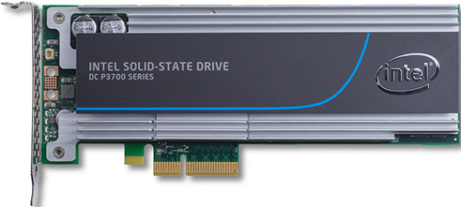
PCIe NVMe (Non-Volatile Memory Express)
NVMe is an industry standard communication protocol using PCIe bus
PCIe bus provides direct connection to CPU, rather than using an I/O controller like SAS or SATA
Designed for non-volatile memory (NVM) like SSDs and Flash
Moves data closer to CPU for maximum performance
Advantages of PCIe
Lower latency than SAS or SATA
Scalable performance (1GB/s per lane)
Increased I/O (up to 40 PCIe lanes per CPU socket)
Low power requirements
Notes:
PCIe has performance advantages over both SAS and SATA I/O controllers. Intel has adopted the industry standard NVMe protocol, along with the PCIe interface to place the storage as close to the processor as possible. This provides low latency, scalable performance and increased I/O.

Slide 7
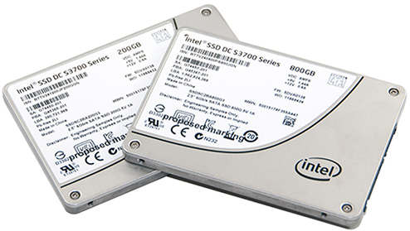
SSD Reliability − Silent Data Corruption (SDC)
Definition: Errors that occur during the write process that are not reported or corrected (silent) by the server.
Caused by a number of factors
Cosmic radiation
Errors in disk firmware
Other software and hardware problems
Not discovered until the data or file is read
Study found 1 corrupt file in every 1,500 files *
Affects both HDDs and SDDs
*ZDNet: “Data Corruption is worse than you know”
Notes:
Silent errors that occur during the write process which are not reported or corrected (silent) by the server and its subsystems are known as Silent Data Corruption (SDC). These errors can be caused by a number of factors, such as cosmic radiation, errors in disk firmware, and other software and hardware problems. Since they are not detected or reported they are ‘silent’ until the data or file is read and the corruption detected.
These type errors are very troubling, since there is no indication the data is incorrect. The ZDNet article “Data Corruption is worse than you know” discusses experiments at CERN, the world’s largest particle physics lab. They analyzed a 8.7TB database and found one data corruption error in every 1,500 files - none of which were reported or corrected when the data was written. . The Enterprise Storage article “Keeping Silent About Silent Data Corruption” discusses a few incidents, along with the challenges of tracking SDC in the data center.
Why is this important? SDC is also a problem for HDDs, but experts believe SSDs are more prone to SDC than HDDs mainly because of the density of the storage material. Intel takes steps other competitive SSD manufacturers do not to ensure the error rate for SDC is 0% The Intel article Data Integrity in Solid-State Drives: What a Supernovas Mean to You provides a detailed explanation of the extensive testing and verification of all Intel series SSD to eliminate Silent Data Corruption in their SSDs.
Intel’s SSD firmware is written to reduce the probability of SDC to virtually zero, provide fast, consistence performance and uniform endurance with low overhead.
Not only does Intel provide protection from SDC, but they also are the only vendor to do radiation testing of their SSD drives at the Indiana University Cyclotron Facility and Los Alamos Nuclear Science Center. This extra testing is an important competitive advantage for Intel.
Intel describes in detail how they tested both Intel and competitor SSDs using a particle accelerator in the techreport.com article Behind the Scenes with Intel SSD Division

Slide 8
SSD Performance Consistency
Performance consistency is key in an enterprise RAID environment
The performance of a RAID set is limited by the lowest performing drive
As a RAID set increases the number of drives, the probability of any given drive performing poorly, and limiting overall performance, increases
SSDs feature a wide performance variation when compared to HDDs
Wide performance variations are also seen among competing enterprise SSDs and SSD vendors
A sacrifice of a small amount of top speed is sometimes required to provide consistent performance
Notes:
Performance consistency is key in an enterprise RAID environment because the performance of a RAID set is limited by the lowest performing drive. As a RAID set increases the number of drives, the probability of any given drive performing poorly, and limiting overall performance increases. Therefore, if a SSD or HDD drive is inconsistent with its performance, the inconsistency decreases the performance of the entire RAID set. SSDs feature a wide performance variation when compared to HDDs. Wide performance variations are also seen among competing enterprise SSDs making the selection of a consistently preforming SSD an important selection criteria. SSD drives that stress consistency, like Intel, sacrifice a small amount of top end ‘speed’ to provide a more valuable consistent product.
Tom’s IT Pro article “How We Test Enterprise SSDs” discusses testing methods for enterprise SSDs and presents contains a detailed explanation of testing drives for consistency.

Slide 9
Intel SSD Differentiators − Reliability and Consistency
Reliability
Virtually 0% chance of Silent Data Corruption (SDC) as tested at Los Alamos Nuclear Science Center
Extra testing is a competitive advantage for Intel SSDs; no competitor offers this reliability or event tests for SDC
Include end-to-end data protection & power-loss protection features
Mean time between failure (MTBF) of 2 million hours
Consistency
Intel SSDs consistency − max latencies of less than 500 µs, 99.9% of the time
Provides optimal performance in a RAID array
Competing drives do not make consistency a priority
Notes:
Reliability
Intel’s SSD firmware is written to reduce the probability of Silent Data Corruption (SDC) virtually zero, provide fast, consistence performance and uniform endurance with low overhead.
Not only does Intel provide protection from SDC, but they also are the only vendor to do radiation testing of their SSD drives at the Indiana University Cyclotron Facility and Los Alamos Nuclear Science Center. This extra testing is an important competitive advantage for Intel. – no competitor offers this reliability or even tests for SDC
Each Intel SSD also features a robust Mean Time Between Failures (MTBF) of 2 million hours. In addition, Intel SSDs provide some of the lowest return and failure rates in the industry: This is due in part to the industry leading rigorous testing and validation procedures Intel uses, including performing more than 1M power cycles per product within platform and system validation.
Intel SSD drives provide the following reliability features:
Intel SSDs provide up to 10 Drive Writes per Day or 36.5 PB data written, Provides AES 256-bit Advanced Encryption Standard (AES) data protection, Intel SSDs have industry best 5 year warranty – competitors only offer 3 year warranties, Provide End-to-end Data Protection for data reliability, Have power-loss protection features with built in self-test
Consistency
Performance consistency is key in an enterprise RAID environment because the performance of a RAID set is limited by the lowest performing drive. As a RAID set increases the number of drives, the probability of any given drive performing poorly, and limiting overall performance increases. Therefore, if a SSD or HDD drive is inconsistent with its performance, the inconsistency decreases the performance of the entire RAID set. SSDs feature a wide performance variation when compared to HDDs. Wide performance variations are also seen among competing enterprise SSDs making the selection of a consistently preforming SSD an important selection criteria. SSD drives that stress consistency, like Intel, sacrifice a small amount of top end ‘speed’ to provide a more valuable consistent product.
Tom’s IT Pro article “How We Test Enterprise SSDs” discusses testing methods for enterprise SSDs and presents contains a detailed explanation of testing drives for consistency.

Slide 10
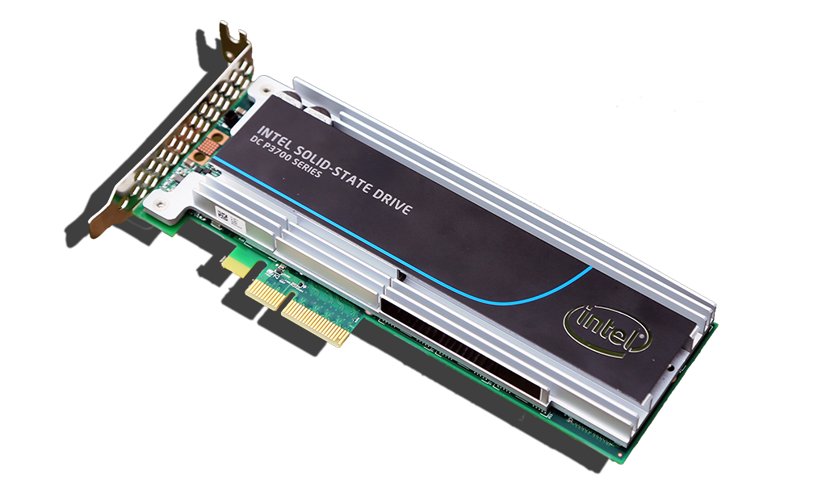
Solid-state Drive Endurance
SSDs have a finite number of program/erase (P/E) cycles
Each SSD has an expected endurance specification
Once exceeded, SSDs switch to ‘read only’ mode
Every vendor provides tools to measure SSD endurance and ‘remaining life’
Endurance is measured by:
Total Bytes Written (TBW) and/or Drive Writes per Day (DWPD)
TBW = DWPD * warranty years * 365 * (capacity/1,024)
DWPD = TBW * (1024/(capacity * warranty years * 365)
Notes:
An SSD has a huge but finite number of program/erase (P/E) cycles. This affects how long a drive can perform write operations, and therefore, its life expectancy. This makes matching the read/write profiles of the SSDs workload to the expected drive endurance important. If the endurance specification of an SSD drive is exceeded, a SSD will switch to ‘read only’ mode – NO DRIVE WRITES WILL BE ALLOWED. This will continue until the drive is replaced or fails completely. Each server manufactures provides tools to monitor endurance and provides reporting to the server administrator.
Because of this, planning must be done to ensure the application read/write profile matches the SSD drives read/write endurance. This will ensure the SSD does not exceed its required life expectancy for drive writes.
There are two primary specifications used to measure SSD drive endurance, Total Bytes Written (TBW) and Drive Writes per Day (DWPD). (Note: Sometimes TBW is referred to as Terabytes Written) The TBW value assigned to a Solid-State device is the total bytes of written data that a drive can be guaranteed to complete. Reaching the TBW limit does not cause the SSD to fail, but at some point after surpassing the TBW value – based upon manufacturing variance margins, the drive reaches the end-of-life point, at which time the drive goes into read-only mode.
DWPD measures how many times you can overwrite the entire capacity of the SSD every day of its usable life without failure during the warranty period. Both TBW and DWPD are guaranteed specifications by the vendor.
The following conversion is useful when comparing the two measurements:
TBW = DWPD * warranty years * 365 * (capacity/1,024)
DWPD = TBW * (1024/(capacity * warranty years * 365)
SSDs are generally classified by vendors using several different terms. “Read centric” or ‘Value” SSDs have very good read performance, but limited write performance and endurance. “Write centric” or ‘Enterprise” SSDs have very good read/write performance and very good endurance. “Mixed Use” SSDs fall in between the performance and endurance of “Read” and “Write” centric drives.

Slide 11
Intel’s HP & Lenovo Solid State Drives
HP $−$ 3 classes of Enterprise SSDs
Read Intensive (RI) | Endurance <=1 DWPD
Mixed Use (MU) | Endurance >1 and <10 DWPD
Write Intensive (WI) | Endurance >= 10 DWPD
Lenovo $−$ 2 classes of Enterprise SSDs
Enterprise Value | Endurance of 24.3 PB TBW
Enterprise | Endurance of 1.0 PB TBW
Notes:
HP Enterprise SSDs are broken up into three classifications and primarily uses the Drive Writes Per Day (DWPD) measurement.
The “Write Intensive” Intel DC S3710 series SSDs have a maximum endurance of 10 DWPD while the “Read Intensive” Intel DC S3510 series SSDs have a maximum endurance of .3 DWPD. The “Mixed Use” Intel DC S3610 series have a maximum endurance of 3 DWPD.
Read Intensive SSDs are priced lower than their “Write Intensive” counterparts, allowing data centers to more affordably service read-intensive workloads while maintaining a very similar, if not the same, read IOPS.
Mixed-Use SSDs feature a middle combination of endurance and price.
Intel’s HP Enterprise SSDs are:
HP Read Intensive – Intel DC S3510 series (SATA), Intel DC P3500 series (PCIe)
HP Mixed Use – Intel DC 3610 series (SATA), Intel DC P3600 series (PCIe)
HP Write Intensive – Intel DC S3710 series (SATA), Intel DC P3700 series (PCIe)
Lenovo classifies their Solid-State drives as either Enterprise or Enterprise Value and primarily uses the TBW (Total Bytes Written) endurance measurement. Both types of drives typically have similar read IOPS characteristics. The major difference is their write IOPS performance and endurance.
For instance, the “Enterprise” Intel DC S3710 series SSDs have a maximum endurance of 24.3 PB TBW while the “Enterprise Value” Intel DC S3510 series SSDs have a maximum endurance of 1 PB TBW. Enterprise Value SSDs are price lower than their Enterprise counterparts, allowing data centers to more affordably service read-intensive workloads while maintaining a very similar, if not the same, read IOPS.
The key difference between Lenovo’s Enterprise and Enterprise Value SSDs are their write IOPS performance, their endurance/life expectancy and price.
Intel’s Lenovo Enterprise SSDs are:
Lenovo Enterprise Value – Intel DC S3510 series (SATA), Intel DC P3500 series (PCIe)
Lenovo Enterprise – Intel DC S3610 series (SATA), Intel DC S3710 series (SATA), Intel DC P3600 series (PCIe), and Intel DC P3700 series (PCIe)

Slide 12
Application Workload Reference
Application Type | Application Characteristic | Application compatible ‘Write’ centric Enterprise SSD drives? | Application compatible ‘Read’ centric Enterprise SSD drives?
OLTP Database | Read & Write Intensive | Yes
Data Warehouse | Read Intensive |  | Yes
Email Server | Read & Write Intensive | Yes
Medical Imaging | Read Intensive |  | Yes
Video on demand | Read Intensive |  | Yes
Web, Internet | Read Intensive |  | Yes
Web 2.0 | Read & Write Intensive | Yes
Notes:
Matching data center workloads to the type SSD drive is important to ensure these drives meet the expected performance and endurance the data center user is expecting.
The following chart provides a reference of workloads and appropriate SSD type

Slide 13
SSD Endurance Perspective
Even ‘Write Centric’ drives can handle a huge amount of drive writes
Drive | Drive Type | Total TBW | TBW/Day for 5 years | TBW/Day for 3 years | RAID 5 Array (4 drives plus parity) | IOPS Write | IOPS Read
Lenovo 400 GB Intel DC S3500 | Read Centric | 225 TB | 123 GB | 205 GB | 492 GB per day | 11,000 | 75,000
Lenovo 400 GB Intel DC S3700 | Write Centric | 7.3 PB | 4 TB | 6.6 TB | 16 TB per day | 36,000 | 75,000
Notes:
From a drive endurance standpoint, both ‘Write’ centric and ‘Read’ centric drives can handle huge numbers of write cycles as illustrated in the following chart.
In a RAID 5 array, where each drive is written to equally, these numbers would be multiplied by the number of drives in the array (less any parity only drives). In a system with four drives plus a parity drive using the Lenovo Intel DC S3500 400GB SSDs, 492 (4X123GB) GB of data could be written per day over 5 years and 820 (4X205) GB of data could be written per day over 3 years. Likewise the Lenovo Intel DC S3700 400 GB SSD would handle a total of 16TB of data written per day over 5 years and 26.4 TB of data written per day over 3 years.
Keep in mind that even if a SSD can handle the endurance needed in the data center, drive write performance is different as listed in the chart for the two drive types. This metric provides a compelling reason to select a ‘write’ centric drive for a heavy write-centric application workload, i.e. OLTP Databases, Web 2.0, E-mail servers.

Slide 14
Which is the Most Important is Application Dependent
Throughput of a SSD is important for applications that work with large files and require a large number of sequential I/O operations such as video-on-demand, medical imaging, and web applications.
Consistency of SSDs are a measure of how the drive performs in the data center.
It is more important than overall peak performance, especially in RAID environments.
Reliability is important to reduce SSD errors such as silent data corruption, and provided end-to-end data protection along with 256-bit AES encryption.
Notes:
Matching data center workloads to the type SSD drive is important to ensure these drives meet the expected performance and endurance the data center user is expecting.

Slide 15
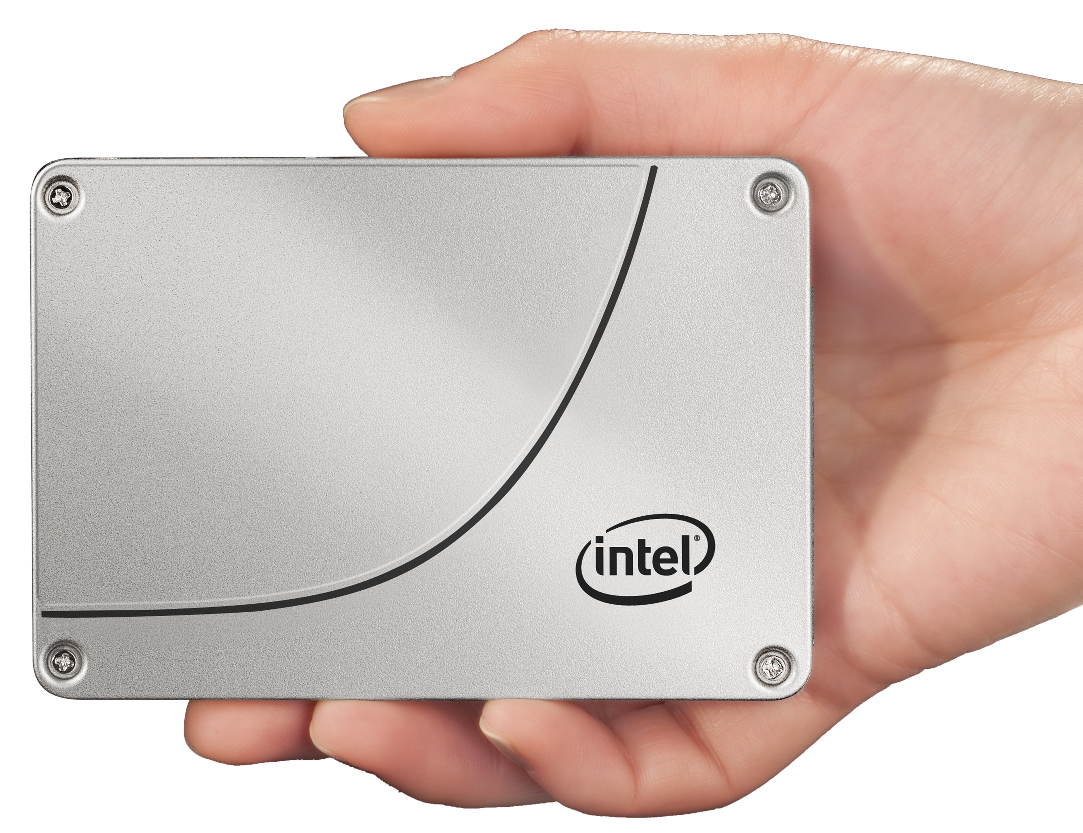
Cost per IPOS vs Cost per GB
Traditionally enterprise disk evaluated by $/GB
HDD have lower $/GB advantage
Performance is evaluated by $/IOPS
SDDs have $/IOPS advantage
Good prospects for upgrading to SSDs
Includes Data Centers using HDD ‘short-stroking’
Use Intel Solid-State Drive Data TCO Calculator to show savings
http://www.intel.com/content/www/us/en/solid-state-drives/ssd-data-center-tco-calculator-tool.html
Notes:
Enterprise disk drives have been traditionally evaluated by cost/GB. While still an important metric, the dramatically better performance of SSDs has made the cost/IOPS a more useful measurement in evaluating disk selection for the data center.
Short-stroking is the practice of purposely restricting the total capacity so that the actuator of a HDD only has to move the heads across a smaller number of total tracks, reducing the average seek time of an HDD. It is a common practice in enterprise servers that increases the number of IOPS for a HDD.
Any data center using short-stroking to increase performance is a great prospect for upgrading their disks to SSDs. They have already invested to gain performance and already see the value. Replacing their current structure with SSDs with the amount of disk they actually use will provide greater performance and a better TCO.

Slide 16
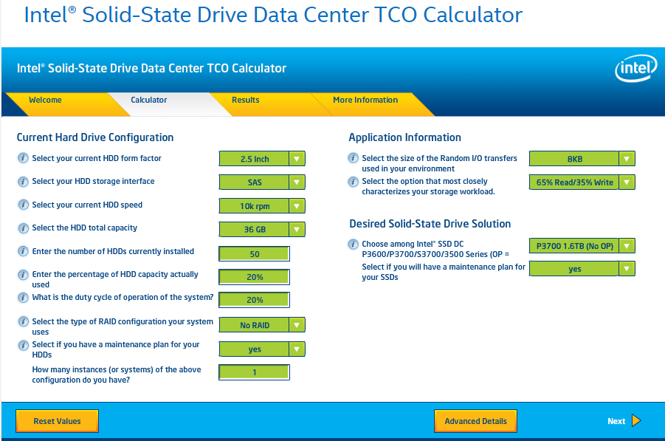
Intel Solid-State Drive TCO Calculator
The Total Cost of Ownership (TCO) Calculator helps discover the potential cost savings of deploying Intel SSDs in a data center.
It also helps determine the number of SSDs and environment would be required to match the performance and capacity of your current HDD configuration.
http://www.intel.com/content/www/us/en/solid-state-drives/ssd-data-center-tco-calculator-tool.html
Notes:
Cost per IOPS vs. Cost per GB
Enterprise disk drives have been traditionally evaluated by cost/GB. While still an important metric, the dramatically better performance of SSDs has made the cost/IOPS a more useful measurement in evaluating disk selection for the data center.
Short-stroking is the practice of purposely restricting the total capacity so that the actuator of a HDD only has to move the heads across a smaller number of total tracks, reducing the average seek time of an HDD. It is a common practice in enterprise servers that increases the number of IOPS for a HDD.
Any data center using short-stroking to increase performance is a great prospect for upgrading their disks to SSDs. They have already invested to gain performance and already see the value. Replacing their current structure with SSDs with the amount of disk they actually use will provide greater performance and a better TCO.
Solid-State Drive Data Center Total Cost of Ownership (TCO) Calculator
Matching the performance and capacity of a data center’s HDD configuration with SSDs can be a complex task, mostly due to the different technology each uses. HDDs have a $/GB advantage. SDDs have an edge over HDDs in:
performance
reliability
power costs
maintenance costs
The $/GB HDD advantage is minimized, and very possibly eliminated in many instances, when the TCO of both HDD and SDD solutions are analyzed. Data centers with:
relatively low HDD capacity used
ones needing more performance
those valuing a savings on power a cooling costs
You can use the Intel Solid-State Drive Data Center TCO Calculator to discover the potential savings of deploying Intel SSDs vs HDDs in these data center environments.

Slide 17
Four Legacy Servers into One Lenovo Intel SSD Server
TPC- H Total Database Performance
Lenovo ThinkServer RD650
With six 800GB SSD
Delivered work of two legacy server workloads
With four 1.6TB Intel P3700 PCIe NVMe SSDs
Delivered work of four legacy server workloads
http://www.principledtechnologies.com/Lenovo/RD650_storage_performance_0415.pdf
Notes:
Lenovo Servers combined with the Intel PCIe NVMe Solid-State drives provide the outstanding performance to replace multiple legacy servers. The total database performance for a Lenovo ThinkServer RD650 using an Intel DC P3700 Series SSD demonstrated a 7x performance increase over legacy server HDDs, allowing this combination to replace four legacy servers based upon testing done by Principled Technologies. http://www.principledtechnologies.com/Lenovo/RD650_storage_performance_0415.pdf
As this study proves, server consolidation using SSD SATA or PCIe disks, rather than new servers is a powerful play for datacenters with database and other transactional workloads.

Slide 18
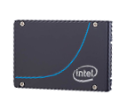
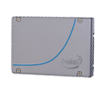
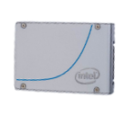
Intel® SSD Data Center PCIe/NVMe™ Family
 | Intel® SSD DC P3700 Series | Intel® SSD DC P3600 Series | Intel® SSD DC P3500 Series
Capacity | 400, 800GB, 1.2 & 1.6TB | 400, 800GB, 1.2, 1.6 & 2.0TB | 400GB, 1.2 & 2.0TB
Interface | PCIe Gen 3 | PCIe Gen 3 | PCIe Gen 3
Form Factor | HHHL AIC & 2.5” | HHHL AIC & 2.5” | HHHL AIC & 2.5”
64KB Sequential R/W Performance | Up to 2800/1900 MBps | Up to 2600/1700 MBps | Up to 2700/1800 MBps
4K Random R/W Performance | Up to 460/175K IOPS | Up to 275/33K IOPS | Up to 430/28K IOPS
Endurance (PB data written) | Up to 62.05 PBW, 17 DWPD | Up to 10.95 PBW, 3 DWPD | Up to 1 PBW, 0.3 DWPD
Average Latency (Read/Write) | 20/20µs | 20/20µs | 20/20µs
Data Integrity | End-to-end data protection | End-to-end data protection | End-to-end data protection
Power Loss Protection Features & Self Test | Yes | Yes | Yes
Limited Warranty | 5 years | 5 years | 5 years
Notes:
The Intel DC P3500, DC P3600, and DC P3700 series provide PCIe and NVMe solutions with outstanding performance in with up to six times faster data transfer speed when compared to 6 Gbps SAS/SATA SSDs. The DC P3700 series has the highest endurance measured by its DWPD of 17, while the DC P3600 series provides 3 DWPD, followed by the DC P3500 series with 0.3 DWPD.

Slide 19
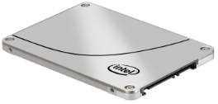
Intel® SSD Data Center SATA Family
 | Intel® SSD DC S3710 Series | Intel® SSD DC S3610 Series | Intel® SSD DC S3510 Series
Capacity | 200, 400, 800GB & 1.2TB | 100*, 200, 400, 480*, 800GB, 1.2* & 1.6*TB | 80, 120, 240, 480, 800GB, 1.2 & 1.6TB
Interface | SATA 6Gb/s | SATA 6Gb/s | SATA 6Gb/s
Form Factor | 2.5” | 2.5” (*2.5 only), 1.8” | 2.5”
64KB Sequential R/W Performance | Up to 550/460 MBps | Up to 500/450 MBps | Up to 500/450 MBps
4K Random R/W Performance | Up to 85/45K IOPS | Up to 84/28K IOPS | Up to 68/20K IOPS
Endurance (PB data written) | Up to 24.3 PBW, 10 DWPD | Up to 10.95 PBW, 3 DWPD | Up to 1 PBW, 0.3 DWPD
Average Latency (Read/Write) | 55/66µs | 55/66µs | 55/66µs
Data Integrity | End-to-end data protection | End-to-end data protection | End-to-end data protection
Power Loss Protection Features & Self Test | Yes | Yes | Yes
Limited Warranty | 5 years | 5 years | 5 years
Notes:
The Intel DC S3710, DC S3610, and DC S3510 series provide:
exceptional performance
strong data protection with 256-bit encryption Advanced Encryption Standard (AES) technology,
full end-to-end data protection
enhanced power-loss protection
The Intel DCS3710 offers 10 DWPD, while the DC S3610 series offers 3 DWPD, and the DC S3510 provides 0.3 DWPD.

Slide 20
Product Information Resources
PCI Express Gen3 Interface | SATA 6 GB/s Interface
Intel SSD DC P3700 Series | Intel SSD DC S3710 Series
Intel SSD DC P3608 Series | Intel SSD DC S3610 Series
Intel SSD DC P3600 Series | Intel SSD DC S3510 Series
Intel SSD DC P3500 Series | Intel SSD DC S3700 Series
 | Intel SSD DC S3500 Series
Notes:
Resource links to Intel Product pages.

