Slide 1
Opening the Door to IT Modernization− Selling Intel SSDs to replace HDDs
1 November 2015

Slide 2
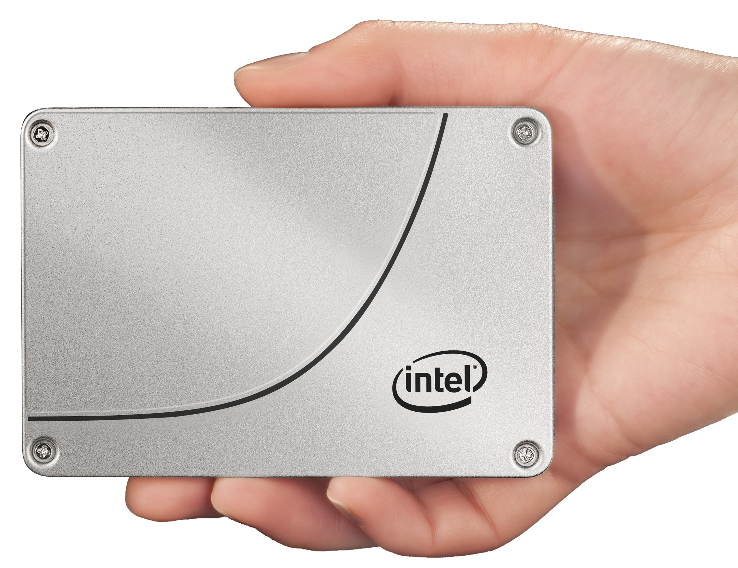
Update Your Server’s Potential with Intel Solid-State Disk Drives
Data center requires enterprise-level reliability with consistent performance.
Business requires an aggressively low total cost of ownership.
Need extreme performance and throughput to drive today’s virtualized and Big Data workloads.
Servers with Intel’s Data Center Solid State Drives (SSDs) can dramatically improve performance and efficiency in the data center.
Notes:
The SSD industry is exploding. According to IDC, the overall market for SSDs globally was $15 Billion in 2015, up 21% from 2014. The driving factors in this growth include lower costs for SSDs, better performing drives, and ease of use -such as the adoption of the NVMe standard for PCIe form factor drives.
2014 enterprise vendor market was reported by IDC to be $4.2B. They also reported the market was led by Intel with 21.4% of the market, followed by Western Digital (who remarked Intel SSD drives) with 14.2%. The combination of these two top providers means that Intel drives provided a commanding 35.6% of the enterprise SSDs. Samsung was the next largest with 14.0%, followed by SanDisk with 11.0% and Micron with 7.1%.
The Enterprise segment for SSDs is estimated to be about 180,000 PBs in 2015. Of this amount, SSDs comprise less than 4% of the total. This leaves a very large market opportunity for both SSDs in new servers, but also as an upgrade to give old servers new life and performance.

Slide 3
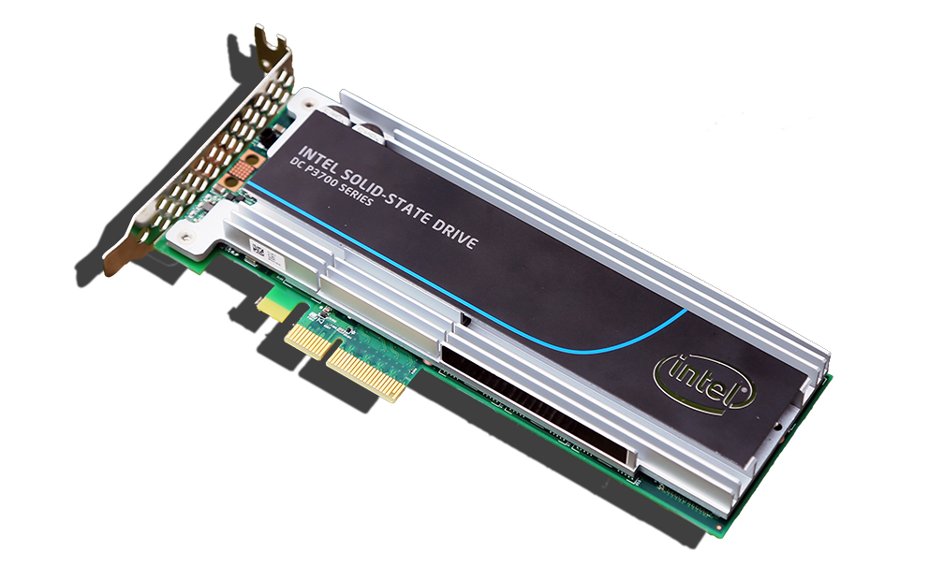
Different Technology, New Dynamics
Solid-State Drive technology is fundamentally different than traditional hard disk drives.
SSDs replace the HDDs mechanical reading process and spinning disk, providing:
Extreme performance and increased throughput
Advanced reliability for the data center
Performance is evaluated by $/IOPS
SDDs have $/IOPS advantage
Use Intel Solid-State Drive Data TCO Calculator to show savings
http://www.intel.com/content/www/us/en/solid-state-drives/ssd-data-center-tco-calculator-tool.html
Notes:
Sold-State Drive technology is fundamentally different than the technology used with traditional hard disk drives. The removal of the mechanical process used by HDDs for reading a spinning disk and replacing it with the Solid-State technology of SDDs provide extreme performance, increased throughput, and advanced reliability to the disk drives in the data center.
Firmware (software) controls the important characteristics of each manufacturer’s SSDs. Each accomplishes the same task – to store data, but they all contain different performance and reliability features. Much like Chrome, Firefox, and Explorer all access the Web with different speed and features.
Enterprise disk drives have been traditionally evaluated by cost/GB. While still an important metric, the dramatically better performance of SSDs has made the cost/IOPS a useful measurement in evaluating disk selection for the data center.
Short-stroking is the practice of purposely restricting the total capacity so that the actuator of a HDD only has to move the heads across a smaller number of total tracks, reducing the average seek time of an HDD. It is a common practice in enterprise servers that increases the number of IOPS for a HDD.
The $/GB advantage HDDs hold can be overcome in many instances when the TCO of both HDD and SDD solutions are analyzed. Data centers with relatively low HDD capacity used, the ones needing more performance, and those valuing a savings on power a cooling costs, can use the Intel Solid-State Drive Data Center TCO Calculator to discover the potential savings of deploying Intel SSDs in a data center environment.

Slide 4
The “Big 4” for Selecting a Data Center Solid-State Drive
Performance
Throughput
Consistency
Reliability
How fast is a random data transfer?
15K SAS HDDs provide only ~230 IOPS
Intel PCIe NVMe & SATA SSDs deliver 75,000 to 460,000 IOPS!
How fast is a sequential data transfer?
15K SAS HDDs provide only ~250 MB/s
Intel SSD’s provide 2,800 MB/s (PCIe NVMe) or 500 MB/s (SATA)
How often does a drive perform at a high rate?
Peak Performance not as important as consistent performance since RAID systems perform at the speed of the lowest performing disk
What data protection features are included?
End-to-end data protection & power-loss protection features
Error Correction
Intel SSD’s provide 300 to 200X performance!
2-10X+ More throughput with Intel SSDs!
Intel SSDs provide maximum latencies of less than 500 µs, 99.9% of the time
Intel SSDs reduce the probability of Silent Data Corruption to virtually 0%!
Notes:
Performance SSDs have much faster access time and throughput than HDDs for random or transactional performance. Some SSDs are so fast that they move the ‘bottleneck’ of performance to another server component or possibly the application itself.
Input/Output Operations per Second (IOPS) is a key metric for disks. A large proportion of the server storage activity is made up of 4K random reads and writes, making this a key benchmark when selecting disks for the data center.
Throughput Sequential throughput, the speed of a sequential data transfer, is an important metric for applications that work with large files and require a large number of sequential I/O operations such as video-on-demand, medical imaging, and web applications
Consistency Performance consistency in an enterprise RAID environment is a key test of how a SSD will perform in the data center. Consistency behind a RAID controller is important because the performance of a RAID set is limited by the lowest performing drive. As a RAID set increases the number of drives, the probability of any given drive performing poorly increases. Therefore, if a SSD or HDD drive is inconsistent with its performance, the inconsistency decreases the performance of the entire RAID set. SSDs feature a wide performance variation when compared to HDDs. Wide performance variations are also seen among competing enterprise SSDs making the selection of a consistently preforming SSD an important selection criteria.
Tom’s IT Pro article “How We Test Enterprise SSDs” discusses testing methods for enterprise SSDs and presents contains a detailed explanation of testing drives for consistency.
Reliability Each Intel SSD series disk also features a robust Mean Time Between Failures (MTBF) of 2 million hours. In addition, Intel SSDs provide some of the lowest return and failure rates in the industry. This is due in part to the rigorous testing and validation procedures Intel uses, including performing more than 1M power cycles per product within platform and system validation.
Intel SSD drives provide the following reliability features:
Intel SSDs provide up to 10 Drive Writes per Day or 36.5 PB data written
Provides AES 256-bit Advanced Encryption Standard (AES) data protection
Intel SSDs have industry best 5 year warranty
Provide End-to-end Data Protection for data reliability
Have power-loss protection features with built in self-test
Virtually zero percent chance of Silent Data Corruption

Slide 5
Intel SSDs Provide HP and Lenovo Servers with the Best Combination of Performance, Throughput, and Reliability!
Extreme Performance
Fast Throughput
Outstanding Consistency
Solid Reliability
Notes:
These are the reasons Intel is #1 vendor in the Enterprise SSD market with 21.4% market share as reported by IDC in 2014. Intel is followed by Western Digital (who remarked Intel SSD drives) with 14.2%. The combination of these two top providers means that Intel drives provided a commanding 35.6% of the enterprise SSDs. Samsung was the next largest with 14.0%, followed by SanDisk with 11.0% and Micron with 7.1%.

