Slide 1
Opening the Door to IT Modernization− Selling Intel SSDs to replace HDDs
1 November 2015

Slide 2
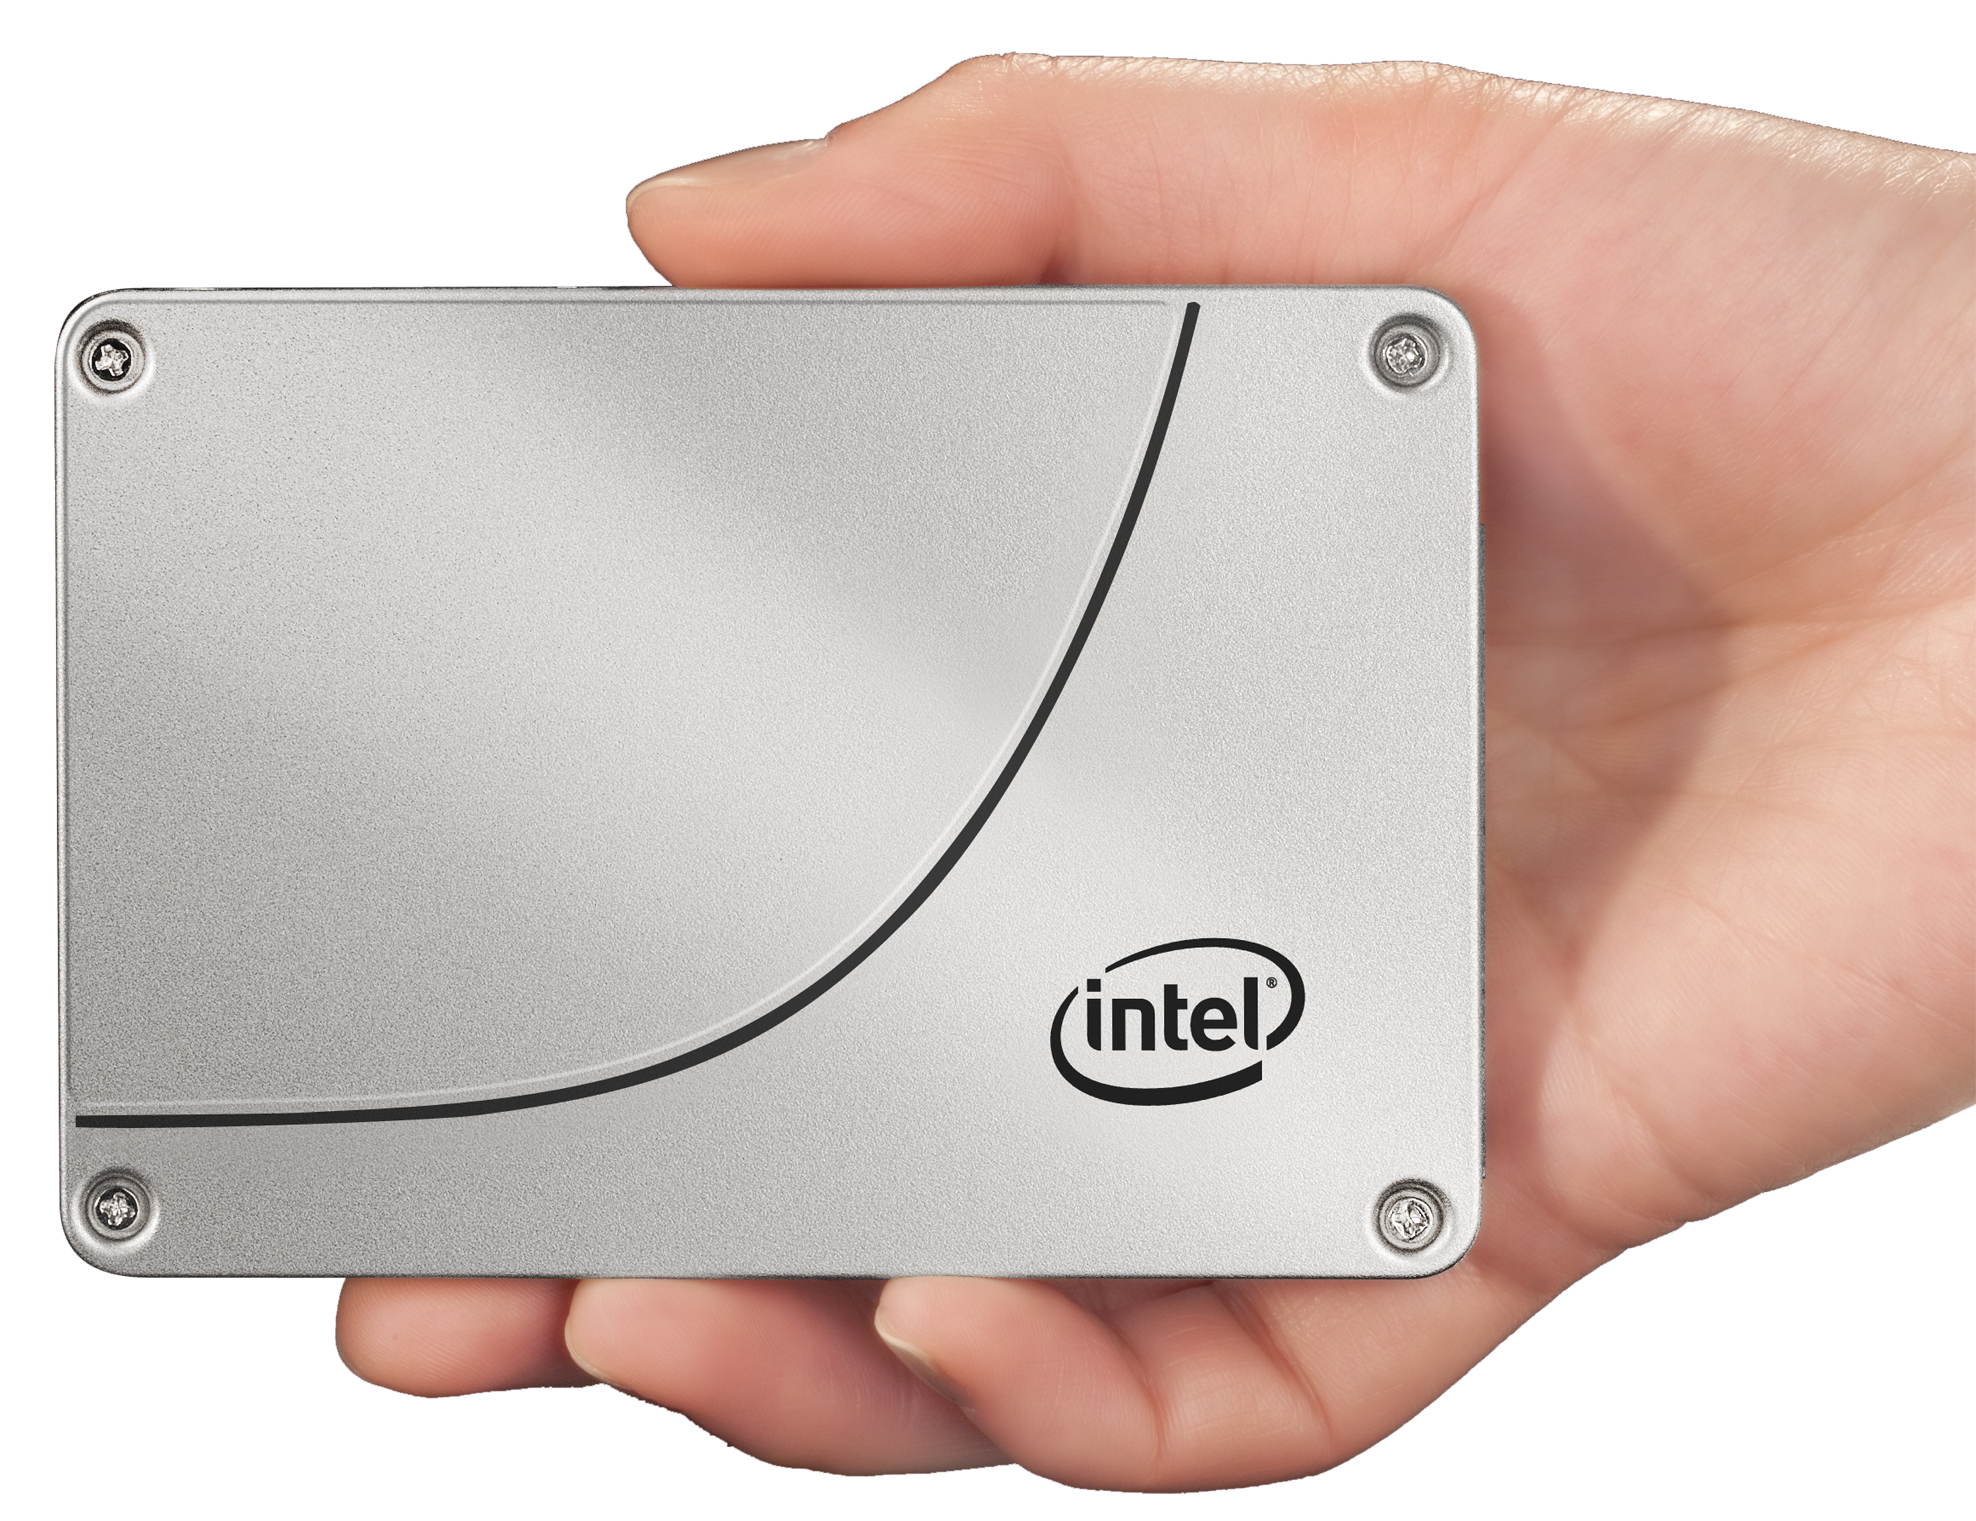
Update Your Server’s Potential with Intel Solid-State Disk Drives
Data center requires enterprise-level reliability with consistent performance.
Business requires an aggressively low total cost of ownership.
Need extreme performance and throughput to drive today’s virtualized and Big Data workloads.
Servers with Intel’s Data Center Solid State Drives (SSDs) can dramatically improve performance and efficiency in the data center.
Notes:
The SSD industry is exploding. According to IDC, the overall market for SSDs globally was $15 Billion in 2015, up 21% from 2014. The driving factors in this growth include lower costs for SSDs, better performing drives, and ease of use -such as the adoption of the NVMe standard for PCIe form factor drives.
2014 enterprise vendor market was reported by IDC to be $4.2B. They also reported the market was led by Intel with 21.4% of the market, followed by Western Digital (who remarked Intel SSD drives) with 14.2%. The combination of these two top providers means that Intel drives provided a commanding 35.6% of the enterprise SSDs. Samsung was the next largest with 14.0%, followed by SanDisk with 11.0% and Micron with 7.1%.
The Enterprise segment for SSDs is estimated to be about 180,000 PBs in 2015. Of this amount, SSDs comprise less than 4% of the total. This leaves a very large market opportunity for both SSDs in new servers, but also as an upgrade to give old servers new life and performance.

Slide 3
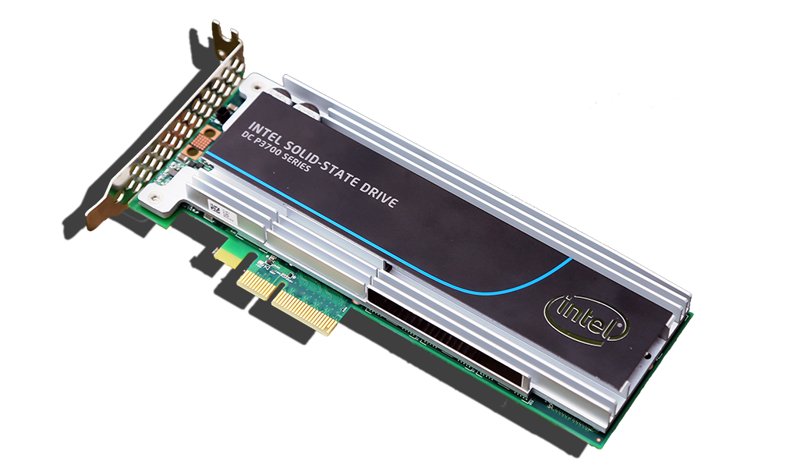
Different Technology, New Dynamics
Solid-State Drive technology is fundamentally different than traditional hard disk drives.
Replaces the mechanical reading process for HDD spinning disk, providing
Extreme performance
Increased throughput
Advanced reliability for the data center
How do I choose – there are so many options?
Firmware controls the important characteristics of each manufacturer’s SSDs making them have different performance and reliability features.
Intel’s SSD firmware is written to provide fast, consistent performance and uniform endurance with low overhead.
Notes:
Sold-State Drive technology is fundamentally different than the technology used with traditional hard disk drives. The removal of the mechanical process used by HDDs for reading a spinning disk and replacing it with the Solid-State technology of SDDs provide extreme performance, increased throughput, and advanced reliability to the disk drives in the data center.
Firmware (software) controls the important characteristics of each manufacturer’s SSDs. Each accomplishes the same task – to store data, but they all contain different performance and reliability features. Much like Chrome, Firefox, and Explorer all access the Web with different speed and features.
Enterprise disk drives have been traditionally evaluated by cost/GB. While still an important metric, the dramatically better performance of SSDs has made the cost/IOPS a useful measurement in evaluating disk selection for the data center.
Short-stroking is the practice of purposely restricting the total capacity so that the actuator of a HDD only has to move the heads across a smaller number of total tracks, reducing the average seek time of an HDD. It is a common practice in enterprise servers that increases the number of IOPS for a HDD.

Slide 4
The “Big 4” for Selecting a Data Center Solid-State Drive
Performance
Throughput
Consistency
Reliability
How fast is a random data transfer?
15K SAS HDDs provide only ~230 IOPS
Intel PCIe NVMe & SATA SSDs deliver 75,000 to 460,000 IOPS!
How fast is a sequential data transfer?
15K SAS HDDs provide only ~250 MB/s
Intel SSD’s provide 2,800 MB/s (PCIe NVMe) or 500 MB/s (SATA)
How often does a drive perform at a high rate?
Peak Performance not as important as consistent performance since RAID systems perform at the speed of the lowest performing disk
What data protection features are included?
End-to-end data protection & power-loss protection features
Error Correction
Intel SSD’s provide 300 to 200X performance!
2-10X+ More throughput with Intel SSDs!
Intel SSDs provide maximum latencies of less than 500 µs, 99.9% of the time
Intel SSDs reduce the probability of Silent Data Corruption to virtually 0%!
Notes:
Performance SSDs have much faster access time and throughput than HDDs for random or transactional performance. Some SSDs are so fast that they move the ‘bottleneck’ of performance to another server component or possibly the application itself.
Input/Output Operations per Second (IOPS) is a key metric for disks. A large proportion of the server storage activity is made up of 4K random reads and writes, making this a key benchmark when selecting disks for the data center.
Throughput Sequential throughput, the speed of a sequential data transfer, is an important metric for applications that work with large files and require a large number of sequential I/O operations such as video-on-demand, medical imaging, and web applications
Consistency Performance consistency in an enterprise RAID environment is a key test of how a SSD will perform in the data center. Consistency behind a RAID controller is important because the performance of a RAID set is limited by the lowest performing drive. As a RAID set increases the number of drives, the probability of any given drive performing poorly increases. Therefore, if a SSD or HDD drive is inconsistent with its performance, the inconsistency decreases the performance of the entire RAID set. SSDs feature a wide performance variation when compared to HDDs. Wide performance variations are also seen among competing enterprise SSDs making the selection of a consistently preforming SSD an important selection criteria.
Tom’s IT Pro article “How We Test Enterprise SSDs” discusses testing methods for enterprise SSDs and presents contains a detailed explanation of testing drives for consistency.
Reliability Each Intel SSD series disk also features a robust Mean Time Between Failures (MTBF) of 2 million hours. In addition, Intel SSDs provide some of the lowest return and failure rates in the industry. This is due in part to the rigorous testing and validation procedures Intel uses, including performing more than 1M power cycles per product within platform and system validation.
Intel SSD drives provide the following reliability features:
Intel SSDs provide up to 10 Drive Writes per Day or 36.5 PB data written
Provides AES 256-bit Advanced Encryption Standard (AES) data protection
Intel SSDs have industry best 5 year warranty
Provide End-to-end Data Protection for data reliability
Have power-loss protection features with built in self-test
Virtually zero percent chance of Silent Data Corruption
Not only does Intel provide protection from SDC, but they also are the only vendor to do radiation testing of their SSD drives at the Indiana University Cyclotron Facility and Los Alamos Nuclear Science Center. This extra testing is an important competitive advantage for Intel.

Slide 5
Which is the Most Important is Application Dependent
Throughput of a SSD is important for applications that work with large files and require a large number of sequential I/O operations such as video-on-demand, medical imaging, and web applications.
Consistency of SSDs are a measure of how the drive performs in the data center.
It is more important than overall peak performance, especially in RAID environments.
Reliability is important to reduce SSD errors such as silent data corruption, and provided end-to-end data protection along with 256-bit AES encryption.
Notes:
Matching data center workloads to the type SSD drive is important to ensure these drives meet the expected performance and endurance the data center user is expecting.

Slide 6
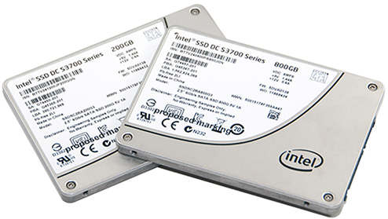
Intel SSD Differentiators – Reliability and Consistency
Intel Reliability
Reducing the probability of Silent Data Corruption* (SDC) to virtually zero
SDC is also a problem in HDDs, but more prevalent in SDDs.
Only Intel does specific testing of their SSD drives to minimize SDC.
Intel’s Industry leading rigorous testing and validation procedures result in some of the lowest return and failure rates in the industry
Intel Consistency
Max latencies of less than 500 µs, 99.9% of the time
Provides optimal performance in a RAID array
* SDC are errors in the data sent to the drive which are not reported or corrected (silent) by the server and its subsystems.
Notes:
Silent Data Corruption
Silent errors that occur during the write process which are not reported or corrected (silent) by the server and its subsystems are known as Silent Data Corruption (SDC). These errors can be caused by a number of factors, such as cosmic radiation, errors in disk firmware, and other software and hardware problems. Since they are not detected or reported they are ‘silent’ until the data or file is read and the corruption detected.
Intel SSD Reliability
Intel’s SSD firmware is written to reduce the probability of SDC to virtually zero, provide fast, consistence performance and uniform endurance with low overhead.
Not only does Intel provide protection from SDC, but they also are the only vendor to do radiation testing of their SSD drives at the Indiana University Cyclotron Facility and Los Alamos Nuclear Science Center. This extra testing is an important competitive advantage for Intel.
Intel SSD Consistency
SSDs in RAID arrays must wait for the last drive to write before moving to the next instruction. Uneven drive performance can slow an entire RAID system far below a SSDs maximum performance advertised by Intel competitors.
Intel SSDs deliver consistency and quality of service by providing maximum latencies of less than 500 µs, 99.9% of the time. These specifications are among the highest in the industry, allowing Intel SSDs to deliver the QoS (Quality of Service) and consistency data centers require to maximize performance. Competing drives do not make consistency a priority, instead focusing on maximizing IOPS performance – while not delivering what most customers need – consistent performance.
The technical brief “Intel Solid-State Drive DC S3700 Series Quality of Service” introduces the metrics on which QoS and performance consistency are measured and characterized and focuses on the importance of QoS in multiple data center applications. In addition, the white paper “Intel SSD DC S3500 Series Workload Characterization in RAID Configurations” looks at performance characteristics in RAID configurations across multiple workloads.

Slide 7
Endurance Drives Optimal SSD Choice
Write Intensive Endurance is important to online transaction processing (OLTP), email servers, and database applications that have a high amount of random I/O requests.
SSD Endurance is measured by Total Bytes Written (TBW) and Drive Writes per Day (DWPD).
HP $−$ 3 classes of Enterprise SSDs
Read Intensive (RI) | Endurance <=1 DWPD
Mixed Use (MU) | Endurance >1 and <10 DWPD
Write Intensive (WI) | Endurance >= 10 DWPD
Lenovo $−$ 2 classes of Enterprise SSDs
Enterprise Value | Endurance of 24.3 PB TBW
Enterprise | Endurance of 1.0 PB TBW
Notes:
An SSD has a huge but finite number of program/erase (P/E) cycles. This affects how long a drive can perform write operations, and therefore, its life expectancy. This makes matching the read/write profiles of the SSDs workload to the expected drive endurance important. If the endurance specification of an SSD drive is exceeded, a SSD will switch to ‘read only’ mode – NO DRIVE WRITES WILL BE ALLOWED. This will continue until the drive is replaced or fails completely. Each server manufactures provides tools to monitor endurance and provides reporting to the server administrator.
Because of this, planning must be done to ensure the application read/write profile matches the SSD drives read/write endurance. This will ensure the SSD does not exceed its required life expectancy for drive writes.
There are two primary specifications used to measure SSD drive endurance, Total Bytes Written (TBW) and Drive Writes per Day (DWPD). (Note: Sometimes TBW is referred to as Terabytes Written) The TBW value assigned to a Solid-State device is the total bytes of written data that a drive can be guaranteed to complete. Reaching the TBW limit does not cause the SSD to fail, but at some point after surpassing the TBW value – based upon manufacturing variance margins, the drive reaches the end-of-life point, at which time the drive goes into read-only mode.
DWPD measures how many times you can overwrite the entire capacity of the SSD every day of its usable life without failure during the warranty period. Both TBW and DWPD are guaranteed specifications by the vendor.
The following conversion is useful when comparing the two measurements:
TBW = DWPD * warranty years * 365 * (capacity/1,024)
DWPD = TBW * (1024/(capacity * warranty years * 365)
SSDs are generally classified by vendors using several different terms. “Read centric” or ‘Value” SSDs have very good read performance, but limited write performance and endurance. “Write centric” or ‘Enterprise” SSDs have very good read/write performance and very good endurance. “Mixed Use” SSDs fall in between the performance and endurance of “Read” and “Write” centric drives.
HP Enterprise SSDs are broken up into three classifications and primarily uses the Drive Writes Per Day (DWPD) measurement.
Read Intensive (RI) – Drives with a typical endurance of less than or equal to 1 DWPD
Mixed Use (MU) - Drives with a typical endurance greater than 1 and less than 10 DWPD
Write Intensive (WI) – Drives with a typical endurance of greater than or equal to 10 DWPD
The “Write Intensive” Intel DC S3710 series SSDs have a maximum endurance of 10 DWPD while the “Read Intensive” Intel DC S3510 series SSDs have a maximum endurance of .3 DWPD. The “Mixed Use” Intel DC S3610 series have a maximum endurance of 3 DWPD.
Read Intensive SSDs are priced lower than their “Write Intensive” counterparts, allowing data centers to more affordably service read-intensive workloads while maintaining a very similar, if not the same, read IOPS. Mixed-Use SSDs feature a middle combination of endurance and price.
Intel’s HP Enterprise SSDs are:
HP Read Intensive – Intel DC S3510 series (SATA), Intel DC P3500 series (PCIe)
HP Mixed Use – Intel DC 3610 series (SATA), Intel DC P3600 series (PCIe)
HP Write Intensive – Intel DC S3710 series (SATA), Intel DC P3700 series (PCIe)
Lenovo classifies their Solid-State drives as either Enterprise or Enterprise Value and primarily uses the TBW (Total Bytes Written) endurance measurement. Both types of drives typically have similar read IOPS characteristics. The major difference is their write IOPS performance and endurance.
For instance, the “Enterprise” Intel DC S3710 series SSDs have a maximum endurance of 24.3 PB TBW while the “Enterprise Value” Intel DC S3510 series SSDs have a maximum endurance of 1 PB TBW. Enterprise Value SSDs are price lower than their Enterprise counterparts, allowing data centers to more affordably service read-intensive workloads while maintaining a very similar, if not the same, read IOPS.
The key difference between Lenovo’s Enterprise and Enterprise Value SSDs are their write IOPS performance, their endurance/life expectancy and price.
Intel’s Lenovo Enterprise SSDs are:
Lenovo Enterprise Value – Intel DC S3510 series (SATA), Intel DC P3500 series (PCIe)
Lenovo Enterprise – Intel DC S3610 series (SATA), Intel DC S3710 series (SATA), Intel DC P3600 series (PCIe), and Intel DC P3700 series (PCIe)

Slide 8
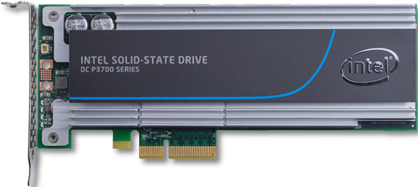
Sell TCO and $/IOPS
Solid-State Drives have a compelling TCO & $/IPOS compared to HDDs
Replace multiple legacy servers with fewer servers and provide better I/O performance
Servers with SSDs are performance efficient
Fewer servers are needed to service application workloads
Total cost of ownership of servers with SSDs is often less than with HDDs
Must Sell TCO over $/GB
$/GB of Servers with HDDs ignores SSDs extreme performance
Evaluate Servers based on workload they perform
Use Intel Solid-State Drive Data TCO Calculator to show savings
http://www.intel.com/content/www/us/en/solid-state-drives/ssd-data-center-tco-calculator-tool.html
Notes:
Enterprise disk drives have been traditionally evaluated by cost/GB. While still an important metric, the dramatically better performance of SSDs has made the cost/IOPS a more useful measurement in evaluating disk selection for the data center.
Short-stroking is the practice of purposely restricting the total capacity so that the actuator of a HDD only has to move the heads across a smaller number of total tracks, reducing the average seek time of an HDD. It is a common practice in enterprise servers that increases the number of IOPS for a HDD.
Any data center using short-stroking to increase performance is a great prospect for upgrading their disks to SSDs. They have already invested to gain performance and already see the value. Replacing their current structure with SSDs with the amount of disk they actually use will provide greater performance and a better TCO.

Slide 9
Study - Four Legacy Servers into One Lenovo Intel SSD Server
TPC- H Total Database Performance
Lenovo ThinkServer RD650
With six 800GB SSD
Delivered work of two legacy server workloads
With four 1.6TB Intel P3700 PCIe NVMe SSDs
Delivered work of four legacy server workloads
http://www.principledtechnologies.com/Lenovo/RD650_storage_performance_0415.pdf
Notes:
Lenovo Servers combined with the Intel PCIe NVMe Solid-State drives provide the outstanding performance to replace multiple legacy servers. The total database performance for a Lenovo ThinkServer RD650 using an Intel DC P3700 Series SSD demonstrated a 7x performance increase over legacy server HDDs, allowing this combination to replace four legacy servers based upon testing done by Principled Technologies. http://www.principledtechnologies.com/Lenovo/RD650_storage_performance_0415.pdf
As this study proves, server consolidation using SSD SATA or PCIe disks, rather than new servers is a powerful play for datacenters with database and other transactional workloads.

Slide 10
Intel SSDs Provide HP and Lenovo Servers with the Best Combination of Performance, Throughput, and Reliability!
Fast Throughput
Up to 2,800 MB/s sequential throughput
Outstanding Consistency
Maximum latency of <500 µs 99.9% of the time
Solid Reliability
Virtually zero percent chance of Silent Data Corruption
Extreme Performance
Up to 460,000 random IOPS
Notes:
These are the reasons Intel is #1 vendor in the Enterprise SSD market with 21.4% market share as reported by IDC in 2014. Intel is followed by Western Digital (who remarked Intel SSD drives) with 14.2%. The combination of these two top providers means that Intel drives provided a commanding 35.6% of the enterprise SSDs. Samsung was the next largest with 14.0%, followed by SanDisk with 11.0% and Micron with 7.1%.

